Slide 1


glad

Slide 2
happy

Slide 3
joyful

Slide 4

cold

Slide 5
freezing

Slide 6
chilly

Slide 7
frosty

Slide 8

fast

Slide 9
quick

Slide 10
swift

Slide 11

like

Slide 12
enjoy

Slide 13

always

Slide 14
forever

Slide 15

stone

Slide 16
rock

Slide 17

street

Slide 18
road

Slide 19

sick

Slide 20
ill

Slide 21
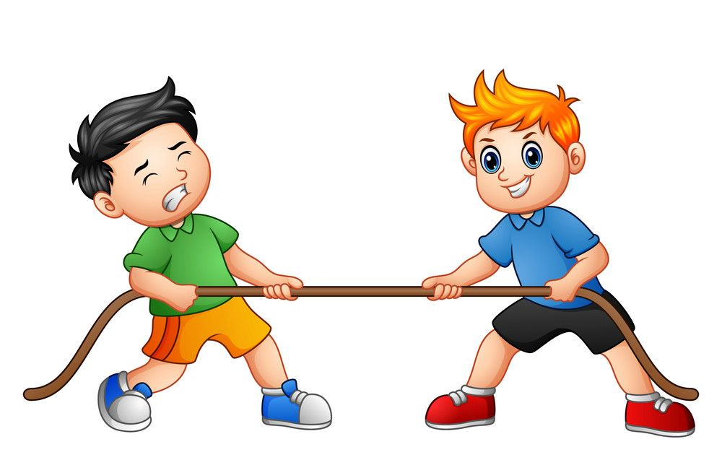
tug

Slide 22
pull

Slide 23
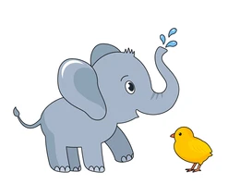
big

Slide 24
huge

Slide 25
large

Slide 26
little

Slide 27
small

Slide 28
tiny

Slide 29

easy

Slide 30
simple

Slide 31

calm

Slide 32
peaceful

Slide 33

noisy

Slide 34
loud

Slide 35

smart

Slide 36
clever

Slide 37
intelligent

Slide 38

angry

Slide 39
upset

Slide 40
furious

